Slide 1

AutoGuard AI Predictive Vehicle Care with Security & Explainability
By Rushikesh and Shruti
Presented by Rushikesh and Shruti

Slide 2


Team Details
Member 1: Rushikesh Kadu College: Sri Balaji University, Pune Contact: 9307329483 Role: Frontend & UI Developer Tech Stack Used: HTML/CSS, JS, React, Tailwind CSS, Vite
Member 2: Shruti Kumari College: Sri Balaji University, Pune Contact: 8357862579 Role: Backend & Logic Developer Tech Stack Used: Nodejs, MongoDB, Express, Postman

Slide 3
Executive Summary
AutoGuard AI is an end-to-end predictive vehicle care platform that combines telematics, driver-behaviour analytics, and explainable machine learning to detect high-risk failures before they occur and automate remediation through booking and actionable counterfactual guidance. The system ingests continuous sensor streams (engine temperature, vibration, OBD readings), eventized driving signals (harsh braking, acceleration patterns), and contextual fleet metadata. A modular agent architecture (Telematics, Driver Behavior, Diagnosis, Scheduling, UEBA, and a Master Orchestrator) runs real-time scoring and returns a concise, explainable alert card that includes the failure probability, SHAP-based feature contributions and a short counterfactual (“reduce harsh braking by 50% → risk falls to 41%”). For fleets and OEMs, AutoGuard AI reduces unplanned downtime, lowers maintenance costs and shortens time-to-service by automating booking choices (nearest/cheapest/earliest) while simultaneously protecting the orchestration layer with UEBA monitoring that detects and blocks anomalous automation or API misuse. The platform outputs two deliverables: (a) immediate user actions (booking, driver coaching), and (b) aggregated RCA patterns for manufacturers to feed back into design and warranty programs. The prototype demonstrates simulated telematics, a working dashboard, explainability visualization and a UEBA block scenario — showing the judges both the decision logic and the live user flow. AutoGuard AI is designed for fast pilot deployment and measurable KPIs: fewer breakdowns, faster repair cycles and actionable insights that convert predictive alerts into real cost savings.

Slide 4
Problem and Solution
Problem
Target Industry: BFSI / FinTech / Enterprise Risk Management
Industry Type: B2B
User Group: Risk Analysts, Compliance Officers, Operations Teams User Department: Risk & Compliance / Operations
Problem Definition: Organizations struggle to detect fraudulent or high‑risk activities in real‑time due to fragmented data, static rules, and delayed reporting. This leads to financial losses, regulatory penalties, and reputational damage.
Solution
Solution Scenario (User Flow): User logs into dashboard → system ingests transaction data → AI engine evaluates risk → risk score & alerts generated → user reviews flagged cases → action taken.
Proposed Data Flow: Data ingestion → preprocessing → risk scoring engine → alert generation → dashboard visualization → audit logs.
Nature of Output: Web Application Dashboard (with alert system).

Slide 5
Approach & Methodology
Value Proposition: AutoGuard AI provides proactive risk identification instead of reactive investigation. It reduces manual effort, improves detection accuracy, and enables faster response.
Impact Metrics:
Reduction in fraud detection time
False positive rate
Risk detection accuracy
Operational cost savings
Technologies Used:
Frontend: HTML, CSS, JavaScript
Backend: Java / Node.js
Database: MySQL
AI Logic: Rule‑based + ML‑ready architecture
Assumptions & Constraints:
Availability of historical data
Initial rules required for cold start
Internet connectivity for real‑time monitoring
Implementation Feasibility: Modular design enables phased implementation. MVP can be deployed quickly.
Scalability & Security: Role‑based access, encrypted data flow, scalable micro‑service‑ready architecture.
Components to Demonstrate: Dashboard, Risk Score Engine, Alert System, Sample Data Flow.

Slide 6
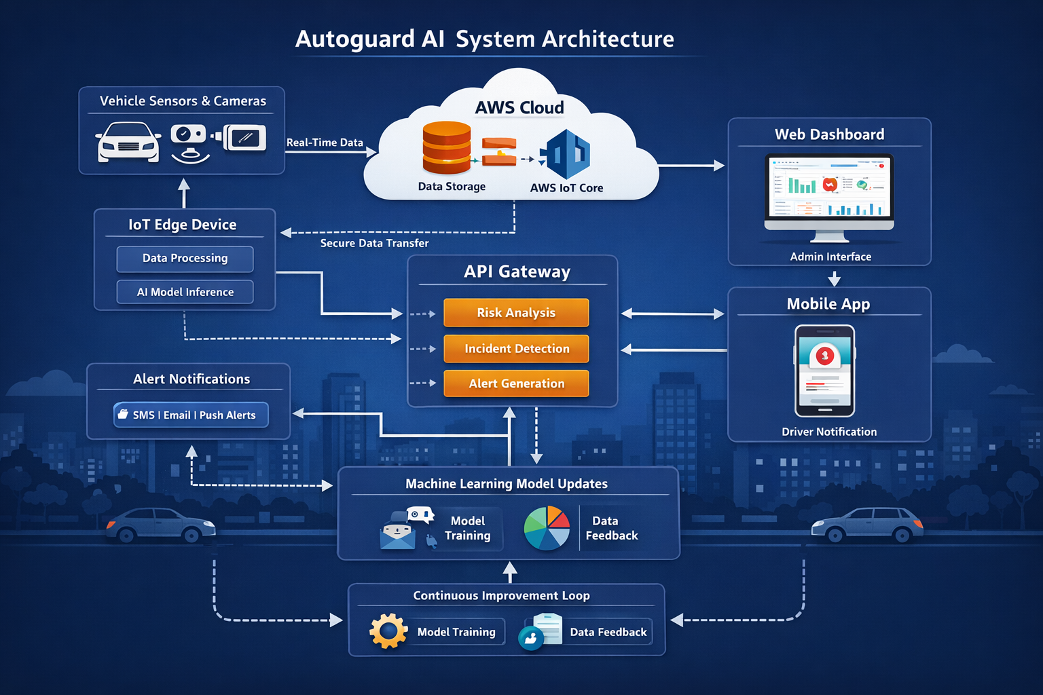
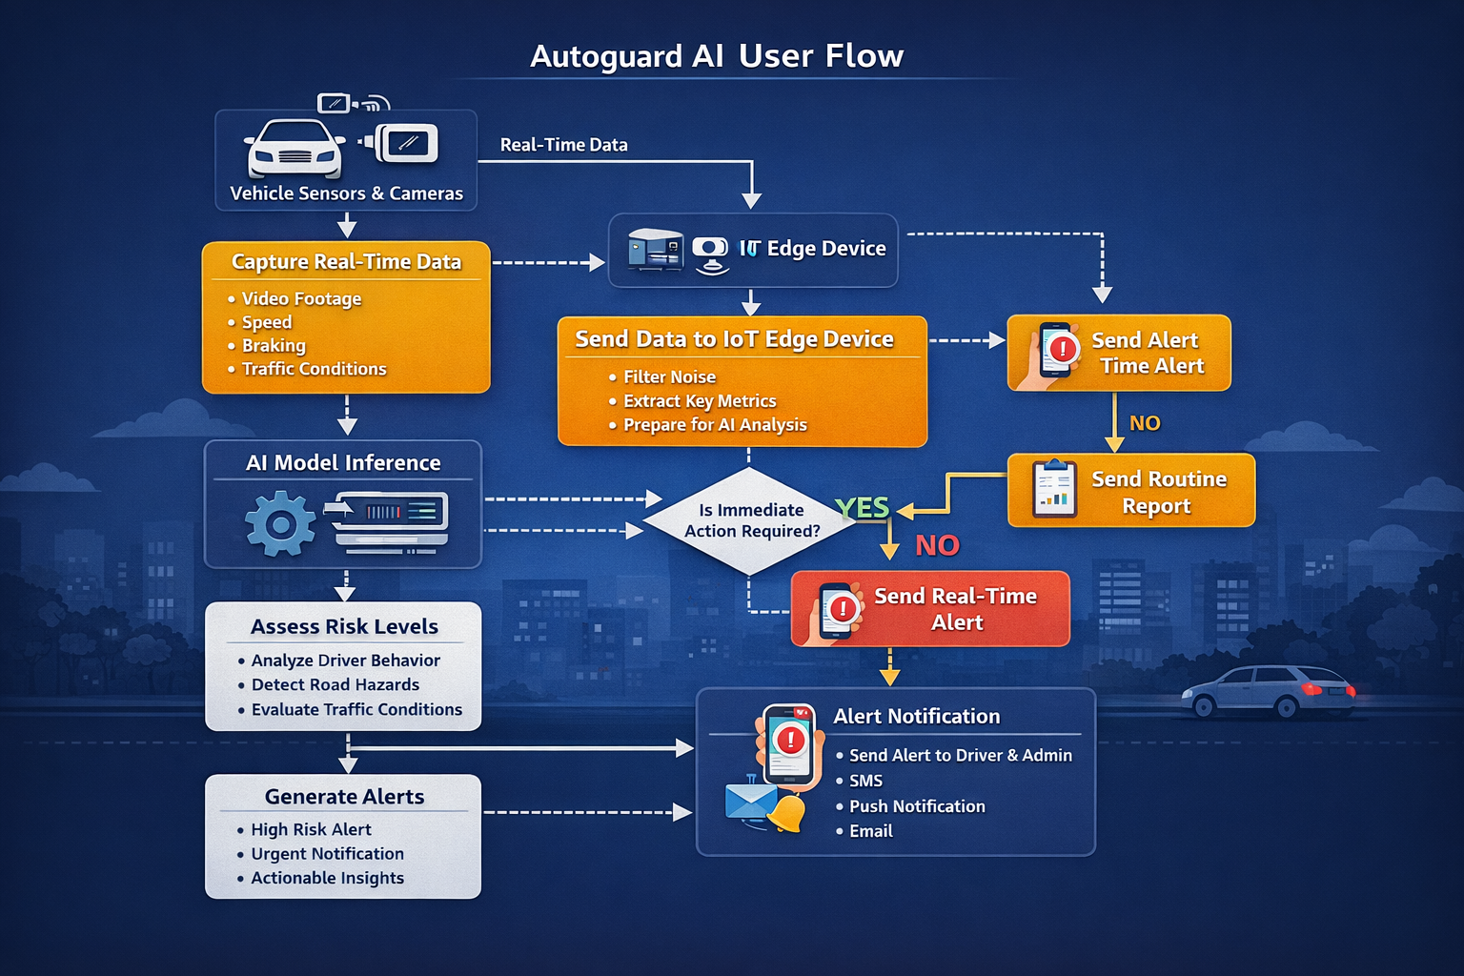
Architecture, Flow & Wireframes
System Architecture Diagram
User Flow Chart
Wireframe Screenshots

Slide 7
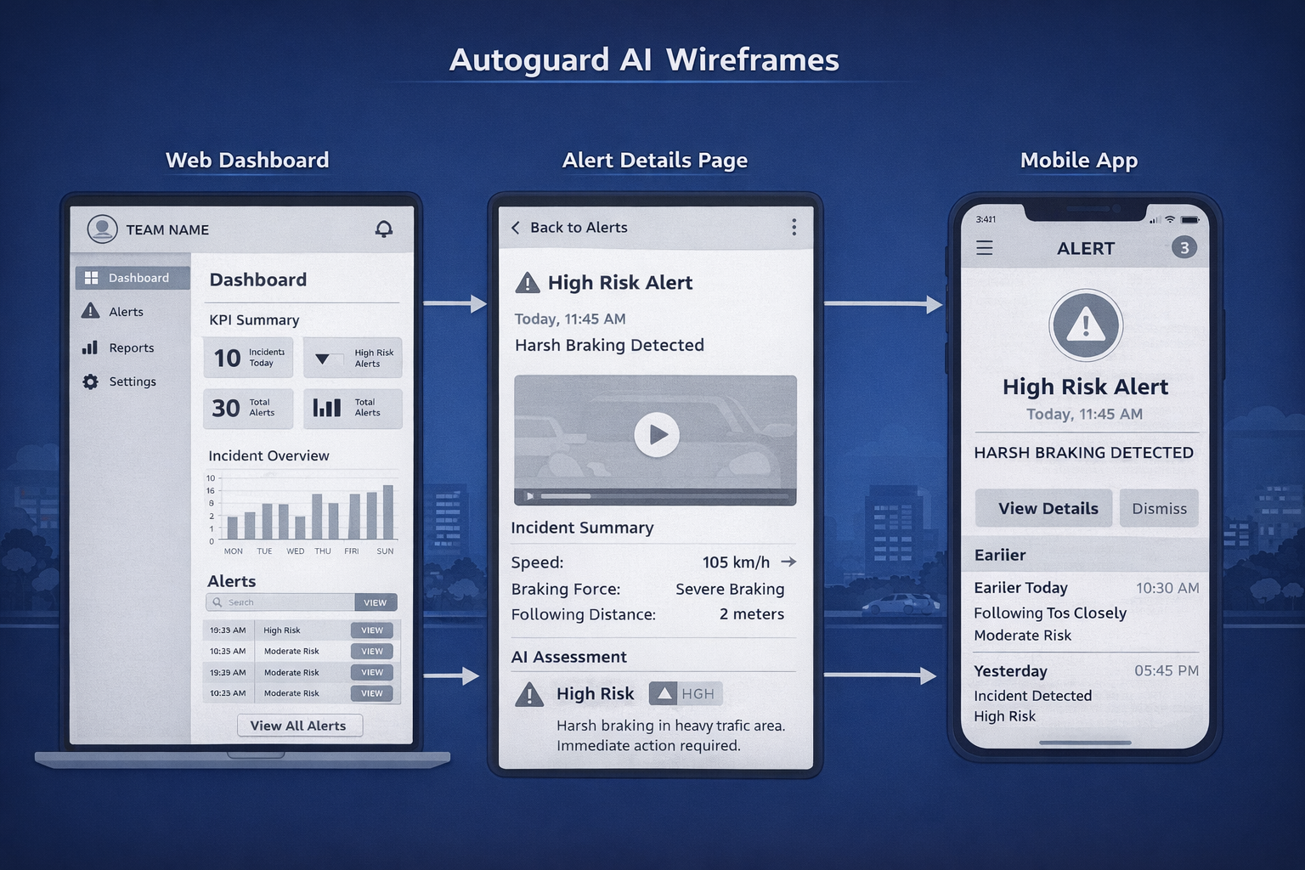
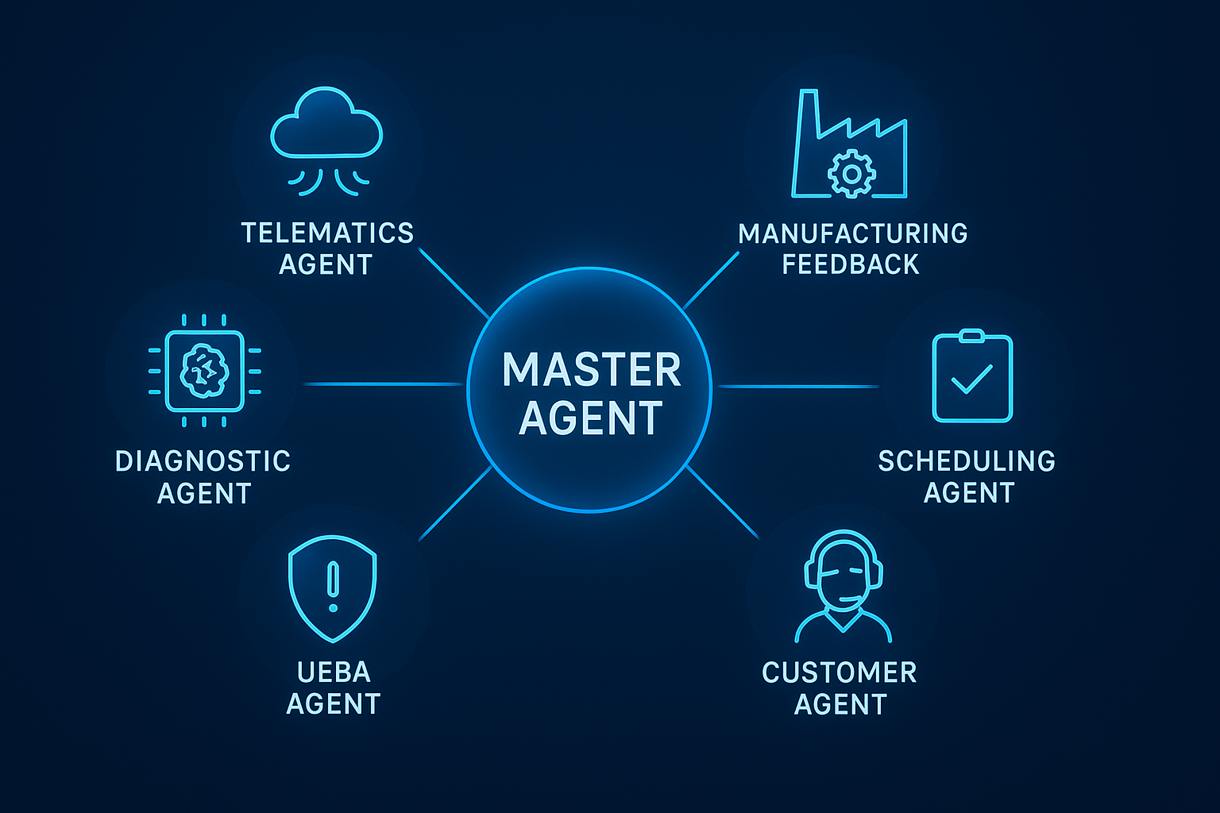

Slide 8
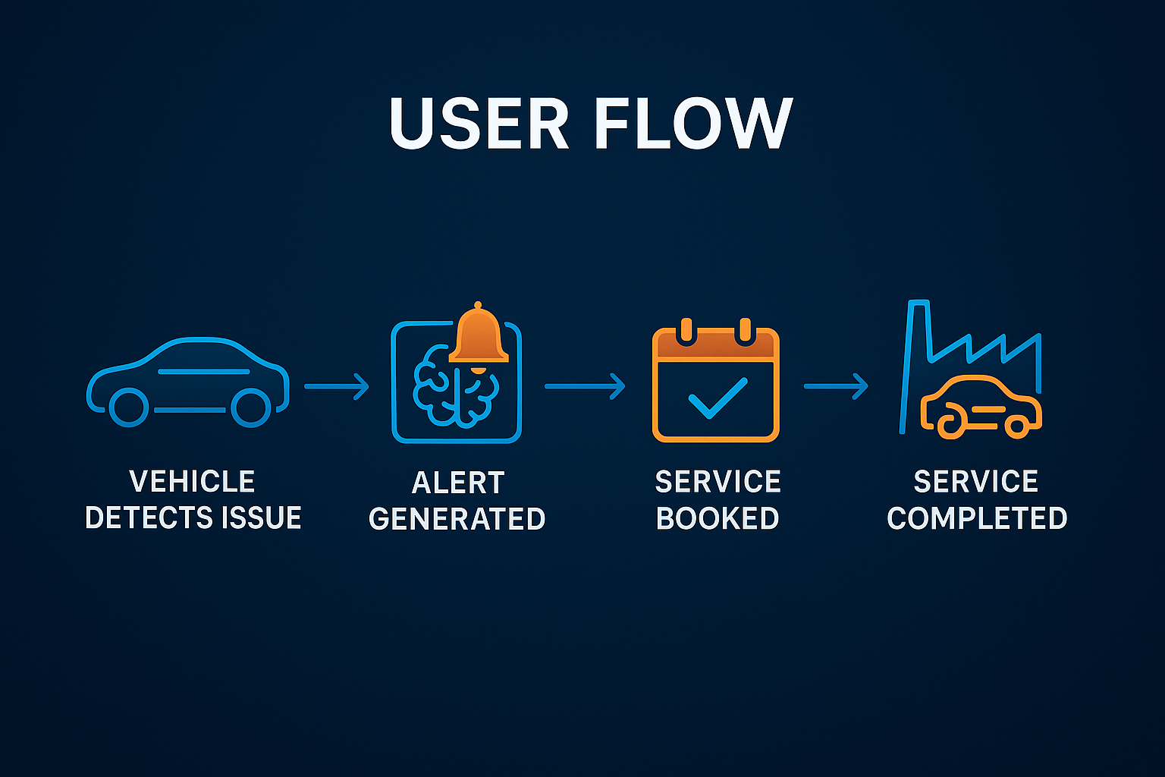
Working Prototype
Counterfactual
Top Risk Driver
Low oil level
High harsh brake count
Elevated vibration reading
What Could Be Different
Reducing harsh braking by 50% would lower the failure risk to 41%. A brake check during your next service could help prevent issues.
Screenshots of dashboard
Risk alert sample
Demo video link (.mp4)

Slide 9
End‑User Impact & Innovation
Uniqueness: Adaptive risk scoring + explainable alerts.
End‑User Benefit: Faster decisions, reduced losses, improved compliance.
Final Note: Prototype is demonstrable and screen‑share ready.
Simulate telematics and driver data
Build basic UI(Dashboard and alert mode
Mock service booking and UEBA simulation

Slide 10
https://drive.google.com/drive/folders/1CNgh_w85hdfiHoq0Hk-EJu-GTkKABGAO?usp=sharing

Slide 11
Thank You

